Slide 1
Rural Same Sex Households in New York State: An Analysis of Demographic and Socioeconomic Characteristics from Census 2000
A. Serdar Atav, PhD
Alice March, RN, MS, PhD(s)
Liang Xie, PhD(s)
State University of New York at Binghamton

Slide 2
Statement of the Problem
Until the 1990 Census, same sex unmarried partner households were unrecognized.
Although the 1990 Census classified same sex partner households, the data were flawed and serious undercounting occurred.
Empirical data and research exploring social, economic, and demographic characteristics of same sex unmarried partner households has been scarce.
As a result, policy needs of same sex households go unnoticed and unmet by policymakers.

Slide 3
Background:
Census 2000 enumerated 105.5 million households of which 54.5 million (52%) were maintained by married couples.
Of the 5.5 million unmarried partner households, 594,000 (11%) were same-sex households (Simmons & O’Connell, 2003).
Geographic analyses of Census 2000 same sex households reveal that gay and lesbian households are a part of the diverse American landscape; from big cities to small farming towns.
According to the simple counts from the Census 2000, all states and 99.3% of counties report same-sex unmarried partner households.
The structure of Census 2000 data makes it very difficult to conduct detailed analyses of subgroups with multiple variables.
Univariate analyses from predetermined tables and counts do not allow for detailed analyses.

Slide 4
Methodology and Data Extraction
1% representative sample raw data (PUMS) was used from Census 2000.
Data were filtered for New York State households that either have:
  male householder and unmarried male partner or
  Female householder and unmarried female partner
An SPSS data set was created by the research team that enabled analyses of all variables in the PUMS data.
The findings can be generalized to New York State.

Slide 5
Location of Same-sex Households in New York State
 | Male / Male Households | Female / Female Households | Total | %
Rural | 45 | 42 | 87 | 19.2%
Urban | 205 | 162 | 367 | 80.8%
Total | 250 | 204 | 454 | 100%

Slide 6
Rural Households in New York State (NYS) by County
County: | Male / Male Households | Female / Female Households | Total | %
Clinton | 7 | 8 | 15 | 17.2
Fulton | 8 | 7 | 15 | 17.2
Cayuga | 7 | 8 | 15 | 17.2
Genesee | 4 | 2 | 6 | 6.9
Allegany | 10 | 11 | 21 | 24.1
Columbia | 9 | 6 | 15 | 17.2
Total | 45 | 42 | 87 | 100

Slide 7
Urban Households by County
County: | Male / Male Households | Female / Female Households | Total | %
Albany | 3 | 4 | 7 | 1.9
Monroe | 6 | 6 | 12 | 3.3
Erie | 5 | 13 | 18 | 4.9
Broome | 7 | 10 | 17 | 4.6
Dutchess | 9 | 13 | 22 | 6.0
Orange | 4 | 4 | 8 | 2.2
Westchester | 7 | 8 | 15 | 4.1
Bronx | 10 | 15 | 25 | 6.8
Manhattan | 59 | 21 | 80 | 21.8
Queens | 28 | 13 | 41 | 11.2
Kings | 39 | 22 | 61 | 16.6
Richmond | 2 | 3 | 5 | 1.4
Nassau | 7 | 10 | 17 | 4.6
Suffolk | 19 | 20 | 39 | 10.6
TOTAL | 205 | 162 | 367 | 100.0

Slide 8
Age & Racial Make Up of Households
 | RURAL |  |  |  |  | URBAN
AGE | M/M |  |  | F/F |  | M/M |  | F/F |  | Total
 | N |  | Mean | N | Mean | N | Mean | N | Mean | N | Mean
Householder | 45 |  | 48.3 | 42 | 45.0 | 205 | 44.2 | 162 | 44.2 | 454 | 44.7
Partner | 45 |  | 47.2 | 42 | 42.7 | 205 | 42.8 | 162 | 41.6 | 454 | 42.8
RACE |  | RURAL |  |  |  | URBAN
 |  | M/M |  | F/F |  | M/M |  | F/F |  | Total
Same Race |  | 97.8% |  | 92.9% |  | 85.4% |  | 90.7% |  | 89.1%
Different Race |  | 2.2% |  | 7.1% |  | 14.6% |  | 9.3% |  | 10.9%

Slide 9
Educational Attainment
 | RURAL |  |  |  | URBAN
 | M/M |  | F/F |  | M/M |  | F/F
 | Householder | Partner | Householder | Partner | Householder | Partner | Householder | Partner
Less than High School | 22.2% | 28.9% | 19.0% | 9.5% | 13.2% | 17.6% | 12.3% | 17.3%
High School | 40.2% | 40.1% | 47.6% | 54.8% | 32.1% | 31.1% | 35.8% | 38.9%
Associate Degree | 6.7% | 0% | 9.5% | 4.8% | 4.9% | 7.3% | 11.1% | 8.6%
Bachelors Degree | 10.0% | 17.8% | 9.5% | 16.7% | 26.3% | 21.5% | 17.3% | 17.9%
Graduate / Professional | 17.7% | 13.3% | 14.3% | 14.3% | 23.4% | 22.5% | 23.5% | 17.3%

Slide 10
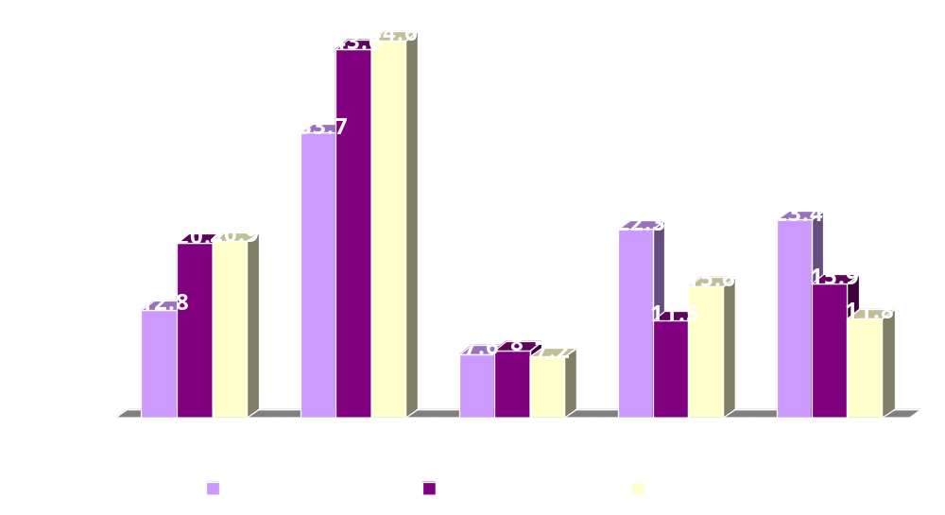
Education: Rural, Urban Same Sex Householder vs All NYS

Slide 11
Household Income in NYS
 | RURAL |  |  |  | URBAN
Income: | M/M |  | F/F |  | M/M |  | F/F |  | Total
 | N | % | N | % | N | % | N | % | N | %
< $10,000 | 1 | 2.2 | 1 | 2.4 | 5 | 2.4 | 11 | 6.8 | 16 | 4.4
$10,000-$24,999 | 9 | 20.0 | 10 | 23.8 | 14 | 6.8 | 19 | 11.7 | 33 | 9.0
$25,000-$49,999 | 14 | 31.1 | 14 | 33.3 | 41 | 20.0 | 30 | 18.5 | 71 | 19.3
$50,000-$74,999 | 8 | 17.8 | 10 | 23.8 | 34 | 16.6 | 26 | 16.0 | 60 | 16.3
$75,000-$99,999 | 4 | 8.9 | 4 | 9.5 | 35 | 17.1 | 25 | 15.4 | 60 | 16.3
>$100,000 | 9 | 20.0 | 3 | 7.1 | 76 | 37.1 | 51 | 31.5 | 127 | 34.6
Total | 45 | 100 | 42 | 100 | 205 | 100 | 162 | 100 | 367 | 100

Slide 12
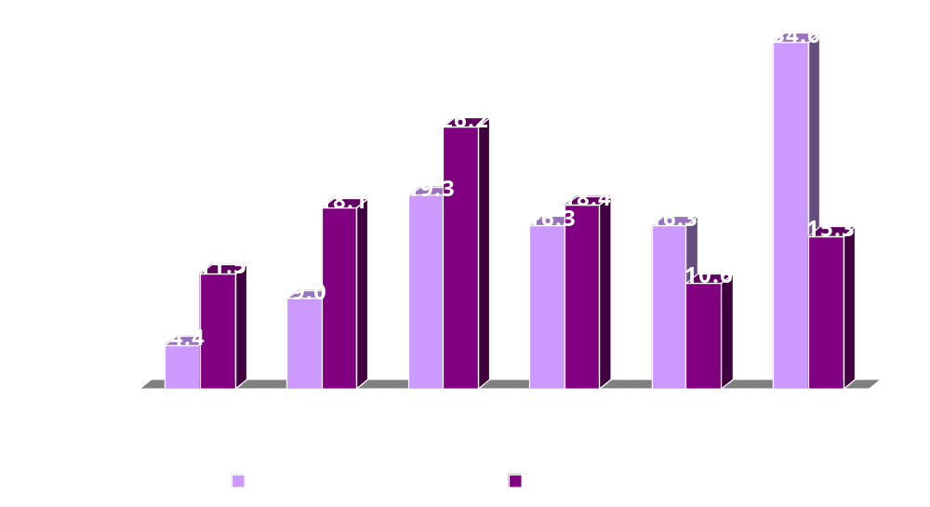
Income: Same Sex vs All Households in NYS

Slide 13
Home Ownership
 | RURAL |  | URBAN
 | M/M | F/F | M/M | F/F | Total
Own | 75.5% | 69.0% | 54.1% | 63.6% | 61.0%
Rent | 24.5% | 31.0% | 45.9% | 36.4% | 39.0%
Median Value | $90,000 | $85,000 | $225,000 | $187,500 | $162,500

Slide 14
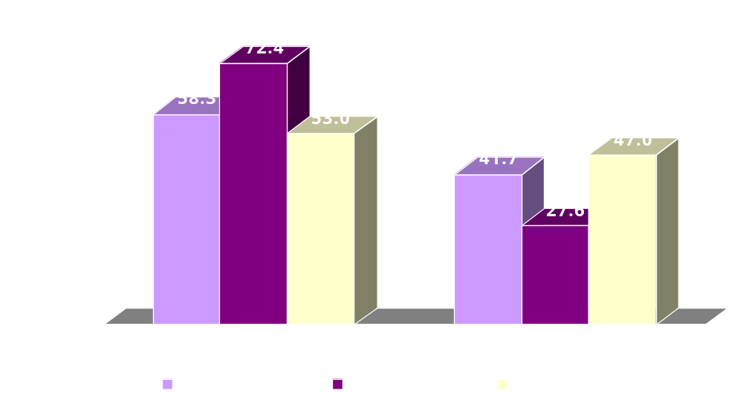
Home Ownership: Rural, Urban Same Sex Households vs All NYS

Slide 15
Householder Marital Status
 | RURAL |  |  |  | URBAN
 | Male |  | Female |  | Male |  | Femal |  | Total
 | N | % | N | % | N | % | N | % | N | %
Married | 0 | 0.0 | 0 | 0.0 | 0 | 0.0 | 0 | 0.0 | 0 | 0.0
Widowed | 4 | 8.9 | 5 | 11.9 | 4 | 2.0 | 17 | 10.5 | 30 | 6.6
Divorced | 13 | 28.9 | 13 | 31.0 | 45 | 22.0 | 54 | 33.3 | 125 | 27.5
Separated | 5 | 11.1 | 6 | 14.3 | 7 | 3.4 | 7 | 4.3 | 25 | 5.5
Never Married | 23 | 51.1 | 18 | 42.9 | 149 | 72.7 | 84 | 51.9 | 274 | 60.4

Slide 16
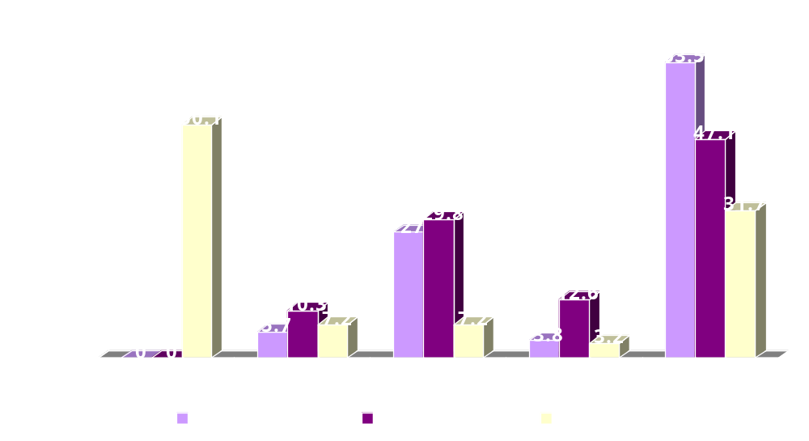
Marital Status: Same Sex Householder vs All Households

Slide 17
Presence of Own Children
 | RURAL |  |  |  | URBAN
 | M/M |  | F/F |  | M/M |  | F/F |  | Total
 | N | % | N | % | N | % | N | % | N | %
Presence of Children | 7 | 15.6% | 14 | 33.3% | 41 | 20% | 49 | 30.2% | 111 | 24.4%

Slide 18
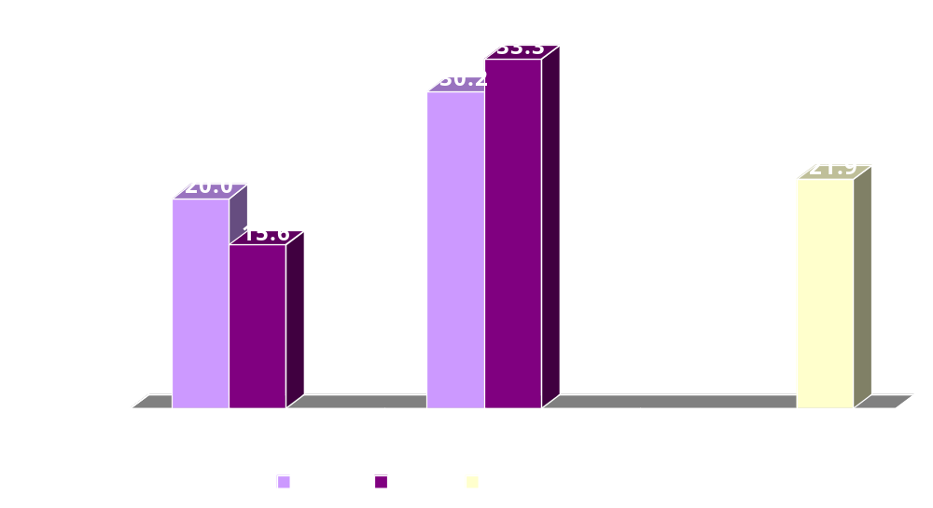
Presence of Own Children Under 18 Years in Household

Slide 19
Disability Status
 | RURAL |  |  |  | URBAN
 | M/M |  | F/F |  | M/M |  | F/F
 | Householder | Partner | Householder | Partner | Householder | Partner | Householder | Partner
Disability (21-64 years) | 15.6% | 12.5% | 27.8% | 16.2% | 18.0% | 22.6% | 21.9% | 15.4%
Disability ( >64 years) | 41.7% | 38.5% | 40.0% | 50.0% | 28.6% | 14.3% | 53.3% | 80.0%

Slide 20
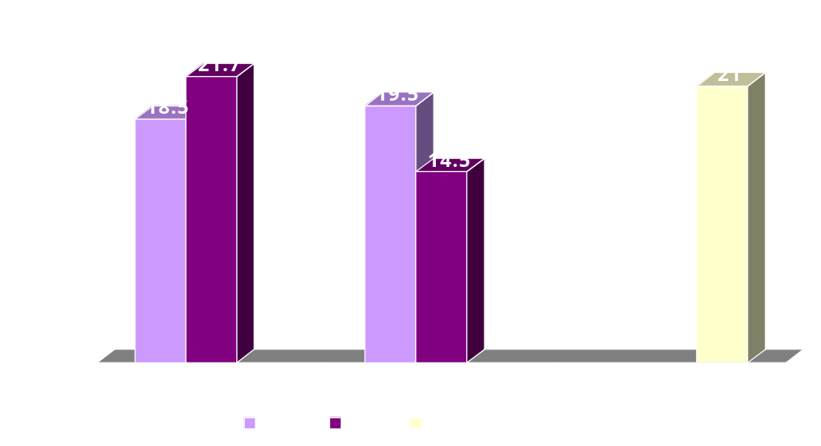
Disability Status: Ages 21–65

Slide 21
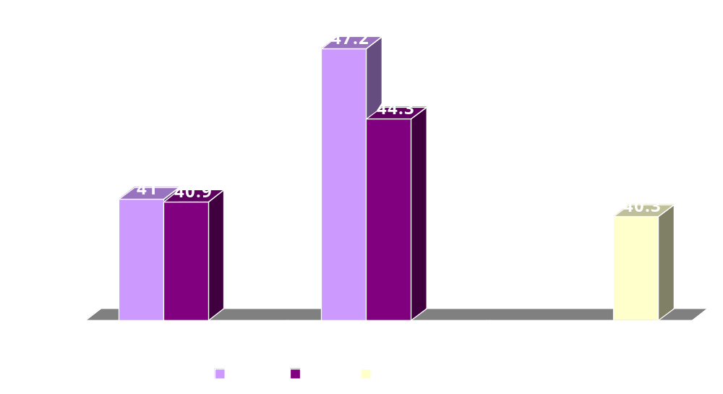
Disability Status: Ages > 65

Slide 22
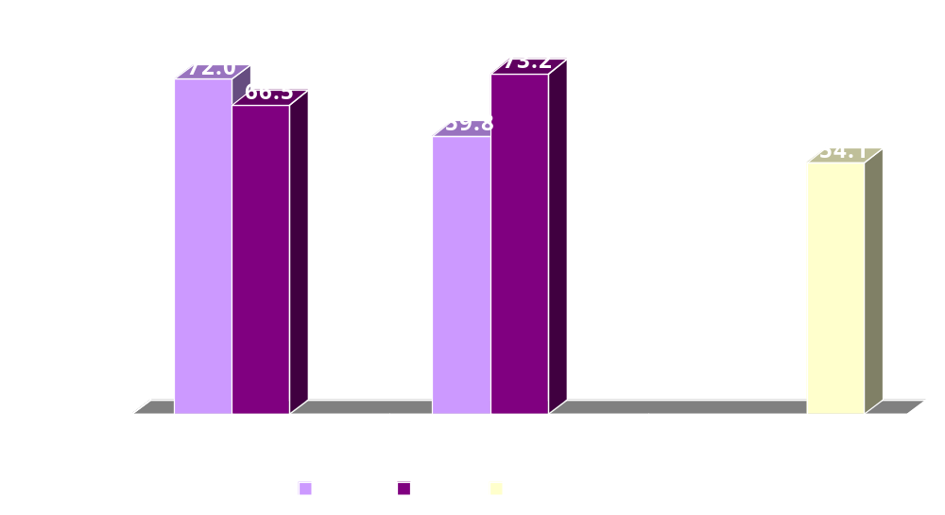
Disability Status: Ages 21–65 % Working with A Disability

Slide 23
Limitations of Data and Future Plans
Same-sex partners are likely to be undercounted.
No questions were asked about sexual orientation, partners who live separately, partners in other household (with parents).
These analyses only included New York State same sex households. Future analyses will include all states.
Future analyses will be based on 5% PUMS data to enhance representativeness.
Methodology to streamline data extraction will be disseminated.

Slide 24
Contact Information:
A. Serdar Atav, PhD
Associate Professor
Associate Director, Kresge Center for Nursing Research
Binghamton University
Binghamton, New York 13902-6000
atav@binghamton.edu
(607) 777-4893

